Slide 1

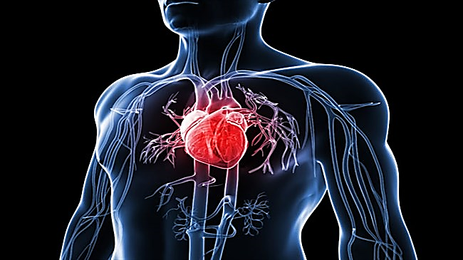
LAKHMI CHAND INSTITUTE OF TECHONOLOGY DEPARMENT OF COMPUTER SCIENCE ENGINEERING
HEART DISEASE PRIDECTION
PRESENTED BY:
Nikita Kumar

Slide 2
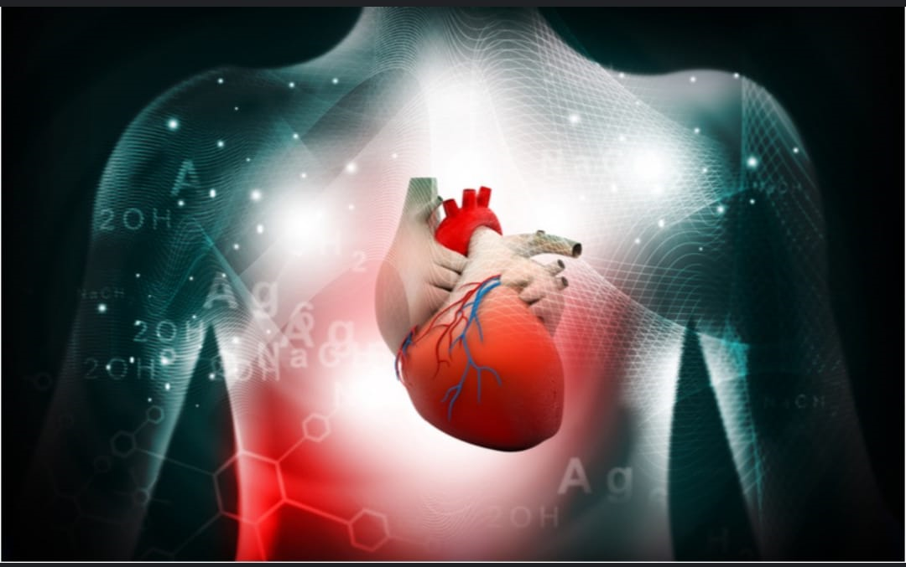

CONTENT
INTRODUCTION
MACHINE LEARNING
REQUREMENT
METHODOLOGY
FUTURE SCOPE
CONCLUSION

Slide 3
INTRODUCTION
Heart disease is a term covering any disorder of the heart . Heart disease have become a major concern to deal with as studies show that the number of deaths due to heart disease have a increased significantly over the past few decades in India , in fact it has become the leading cause of death in India.
Thus preventing heart disease has become more than necessary .Good data driven system for predicting heart disease can improve the entire research and prevention process , making sure that more people can live healthy lives .machine Learning comes into play .Machine Learning helps in predicting the heart disease. And the predictions made are quite accurate .

Slide 4
Heart DiSEASE PREDICTION USING MACHINE LEARNING
Cardiovascular disease is one of the most heinous disease, especially the silent heart attack, which attacks a person so abruptly that there's no time to get it treated and such disease is very difficult the diagnosed. Various medical data mining and machine learning techniques are being implement extract the valuable information regarding the heart disease prediction. Yet , the accuracy of the desired results are not satisfactory . This Model proposes a heart attack prediction system using Machine learning techniques . Health care field has a vast amount of data, for processing those data certain techniques are used. Data mining is one of the techniques often used. Heart disease is the Leading cause of death worldwide. This System predicts the arising possibilities of Heart Disease. The datasets used are classified in terms of medical parameters. This system evaluates those parameter using data mining classification technique . The datasets are processed in python programming using two main Machine Learning Algorithm namely Decision Tree Algorithm and KNN Algorithm which shows the best algorithm among these two in terms of accuracy level of heart disease.

Slide 5

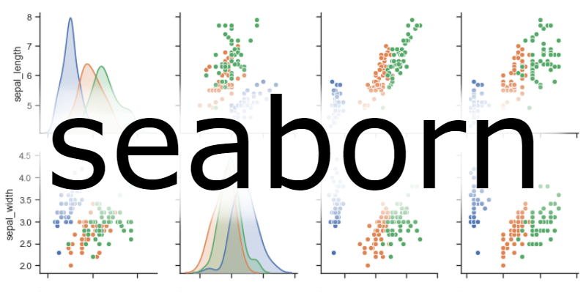

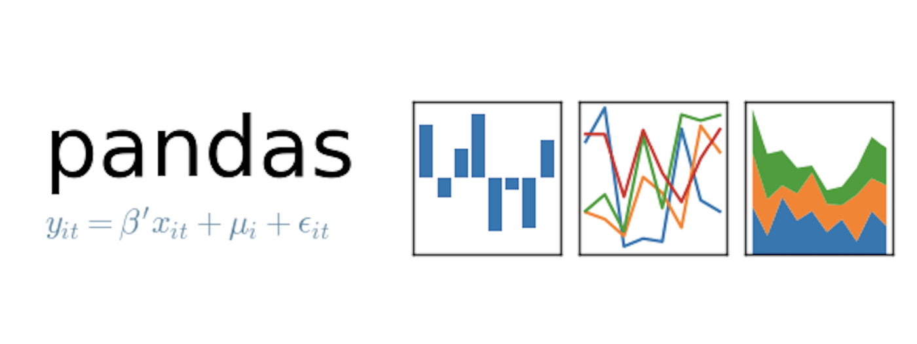
REQUREMENT
SOFTWARE REQURIMENTS
OPERATING SYSTEM :- Windows 7,8,9,10,11(64 bit).
SOFTWARE : - Python 3.7, Anaconda.
Tools : - Jupiter note book IDE,VS CODE
Csv File : - Data Set
HARDWARE REQURIMENT
Hard Disk : - 500GB & Above
RAM : - 4GB & Above
Processor : - 13 & Above

Slide 6
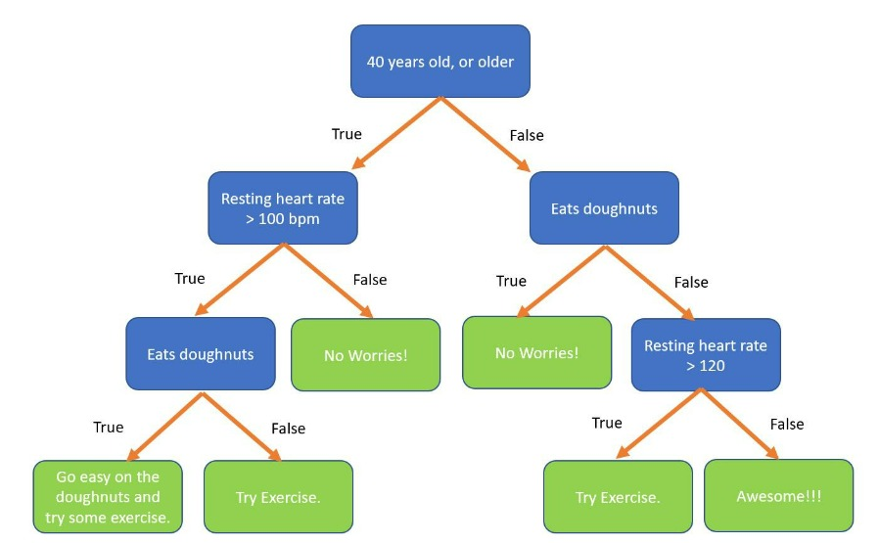
METHODOLOGY
Decision trees
A Decision tree is a non – parametric supervised learning algorithm, which is utilized
For both classification and regression tasks. It has a hierarchical tree structure which
Consists of a root node, branches, internal nodes and leaf nodes.

Slide 7
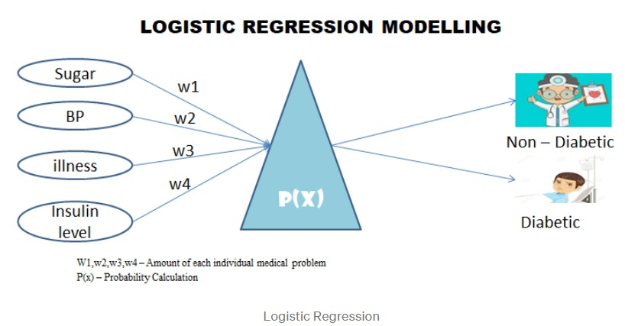
LOGISTIC REGRESSION
Logistic regression is used to describe data and to explain the relationship between one dependent binary variable and one or more nominal , ordinal, interval or ratio-level independent variables.

Slide 8
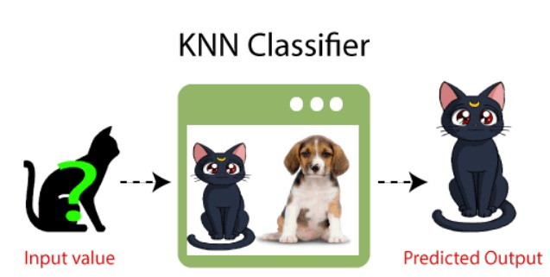
K - NEAREST CLASSIFIER
K-Nearest neighbor is one of the simplest Machine Learning algorithms based on Supervised Learning technique. K-NN algorithm assumes the similarity between the new case/data and available cases and put the new case into the category that is most similar to the available categories . K-NN algorithm stores all the available data and classifies a new data point based on the similarity. This means when new data appears then it can be easily classified into a well suite category by using K- NN algorithm.

Slide 9

FUTURE SCOPE
In future we can use this system for the analysis of different data sets. The performance of the health’s diagnosis can be improved significantly by handling numerous class labels in the prediction process, and it can be another positive direction of research, generally, the dimensionality of the heart database is high, so identification and selection of significant attributes for better diagnosis of heart disease are very challenging tasks for future research.

Slide 10
CONCLUSION
The objective of work is to provide a study of different data mining techniques that can be employed in automated heart disease prediction systems. Various techniques and data mining classifiers are defined in this work which has emerged in recent years for efficient and effective heart disease : diagnosis . The analysis shows that different technologies are used in all the papers with taking different number of attributes .
At the end of this proposal we want to remember that this is fully unique system and we believe that it will helpful for us all as well as any hospital business can add this with their existing features. Hope this system will be vary demandable in coming future.

Slide 11


